Slide 1



AtliQ Mart Supply Chain Project
Chuan Bui Van

Slide 2

PROBLEM AND OBJECTIVES
Problem
pROBLEM
Short oBJECTIVES
Key customers don’t renew contracts with AtliQ Mart
Customer service is evaluated bad by customer
Find the reasons why AtliQ lose their key customers
Keep the key customers
Long term objectives
Increase customer service quality and customer satisfaction
Expand other metros

Slide 3
Executive Summary
Client
AtliQ Mart is a growing FMCG manufacturer headquartered in Gujarat, India.
It is currently operational in three cities Surat, Ahmedabad, and Vadodara.
Key products are food, dairy, beverage
They want to expand to other metros/tier 1 cities in the next 2 years.
Problem
A few key customers did not extend their annual contracts due to service issues.
Some of the essential products were either not delivered on time or not delivered in full over a continued period
Goals
Find reasons why customers leave the client and recommend solutions
Keep key customers and increase customer loyalty

Slide 4
Client Analysis
Data was collected from March 2022 to August 2022
Dairy product orders are almost double than the food and beverage categories
Client focus on developing in Ahmedabad and Vadodara where the population are at 1st and 3rd in Gujarat State respectively
Name | Quantity | Percentage
Order | 31729 | 100%
Product | 13.4M
Order In Full | 16747 | 52.7%
Order On Time | 18730 | 59.03%
Order Intime In full | 9208 | 29.02%

Slide 5
Problem Analysis
Average IF%, OT%, and OTIF% are noticeably lower than the target value
IF% is lower by approximately 31.01% than the IF target
OT% is lower by 31.19% than the target value
OTIF% only reaches 44.02% of target
=> It creates bad customer service when AtliQ cannot provide enough order quantities and late deliveries
=> It makes customers have bad experiences when becoming partners with AtliQ.
IF%: In Full Delivery %
OT%: On Time Delivery% OTIF%: On Time In Full Delivery %

Slide 6
Problem Analysis
AtliQ customers can be divided into 3 main groups based on volume of orders:
Big group includes customers who gain more than 10% in total orders ( Lotus Mart, Acclaimed Stores)
Middle group, which gain from 7% to 10% of total client orders for each ( Vijay Stores, Rel Fresh, Coolblue, Propel Mart)
Small group is customers who gain less than 7% of total orders for each.

Slide 7
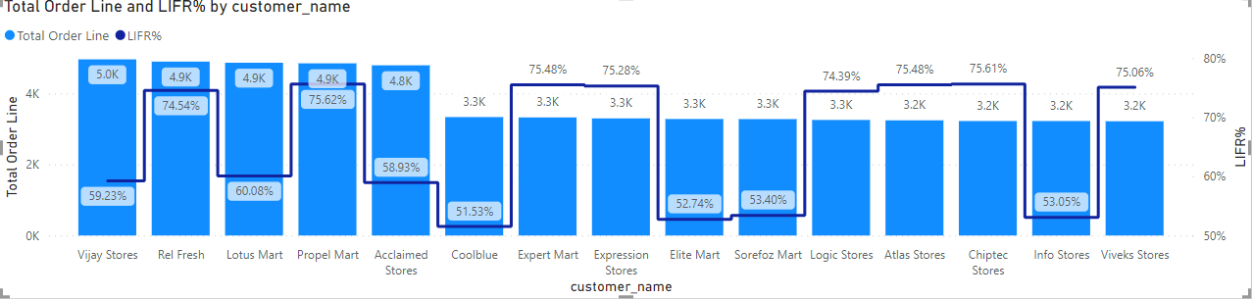
Problem Analysis
Average of LIFR% of AliQ Mart is 65.96%
Initial analysis of the order line overview, nearly half of all customers get LIFR% lower than the average value
Vijay Stores, Lotus Mart, Acclaimed Stores, Coolblue, Elite Mart, Sorefoz Mart, Info Stores
Out of that, Vijay Store, Lotus Mart, and Acclaimed Stores capture nearly 30% of total orders of AliQ Mart

Slide 8
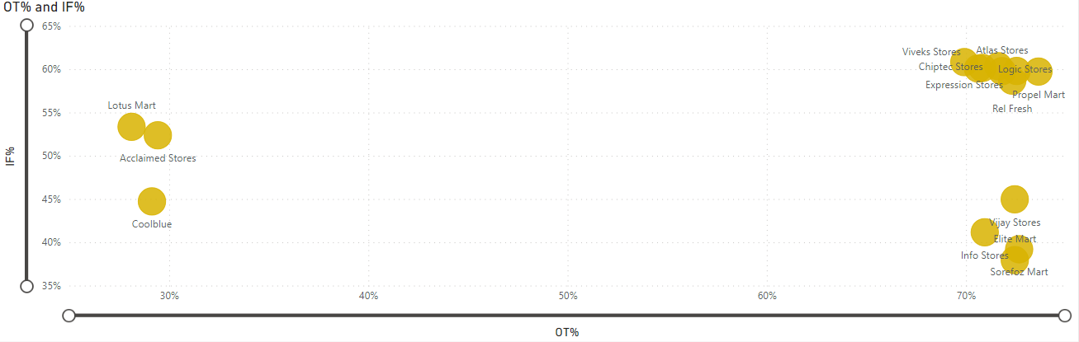
Problem Analysis
Based on OT% value and IF% value, the list of customers can be divided into 3 groups. The client should prioritize the OT% value first and then the IF% value. Therefore, the client can identify customers whose higher leaving rate
Leaving rate ranking group:
Lotus Mart, Acclaimed Stores, Coolblue
Infor stores, Elite Mart, Sorefoz Mart, Vijay Stores
Others

Slide 9
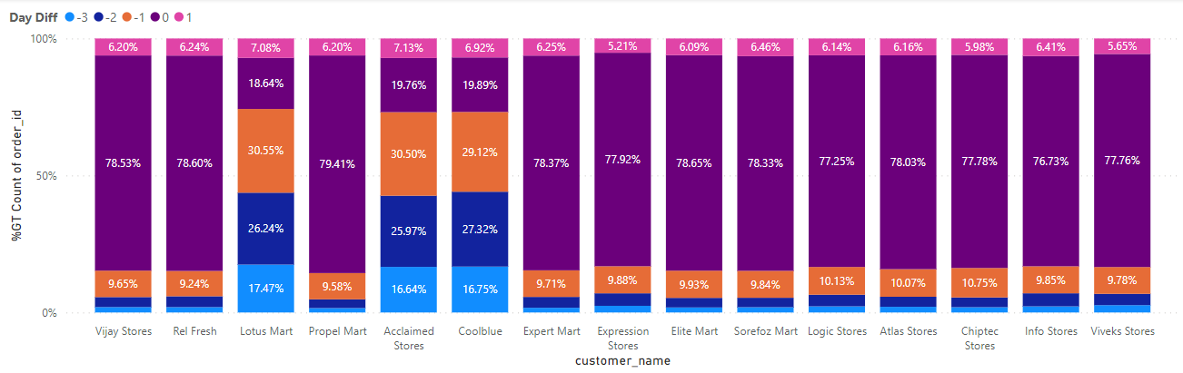
Problem Analysis
When the majority of customers reached more than 80% on-time product delivery or sooner
Lotus Mart only gets 25.72% of product delivery on time or sooner, while the volume of late delivery captures approximately 75%
Similar to Lotus Mart, Acclaimed Stores and Coolblue get roughly 25% on-time delivery and 75% late delivery
AtliQ mart needs to focus more on 3 customers whose higher late delivery rate to improve customer service

Slide 10
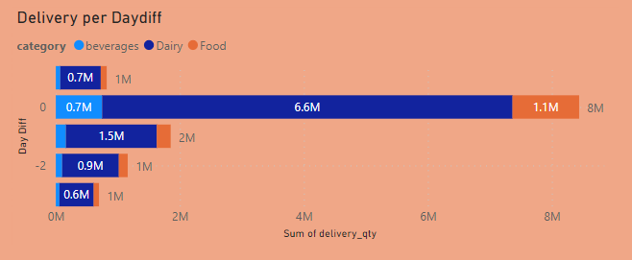
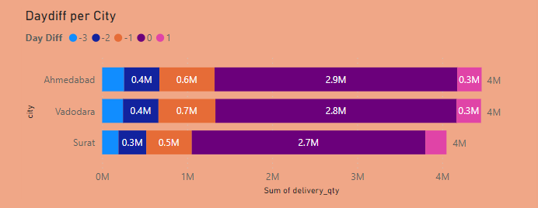
Problem Analysis
Late delivery day is a peak at 1 day after the agreed delivery date, and dairy is the category that gets the highest late rate
Ahmedabad and Vadodara are two cities where the volume of late deliveries is higher than Surat by 25%

Slide 11
Recommendation
Summary
AtliQ Mart is developing strategy plans to enter new cities in India but is facing problems with some key customers who did not renew contracts.
Reason
The reason for this problem is the lousy customer service of AtliQ Mart in delivering products to customers. Some key metrics show AtliQ Mart is operating less effectively compared to their target (IF%: 52.7%/76.51%, OT%:59.03%/86.09%, OTIF: 29.02%/65.91%).
The low IF% value can come from the deficit between the volume of ordered products and the estimated manufacturing capacity.
The low OT% value can come from the lack of delivery vehicles or employees in the delivery process
The customer groups that have the highest leaving rates are Lotus Mart, Acclaimed Stores, and Coolblue, which have lower OT% value but cover nearly 30% of AtliQ Mart’s total orders.

Slide 12
Recommendation
Solution
In the short term, AtliQ Mart must find ways to keep customers who want to leave and improve customer loyalty. Solutions can be discounts in price when increasing the volume of orders or decreasing the price
Making some changes in supply chain management systems. The client needs to estimate the ability, manufacturing capacity, and customer demand to ensure no oversupply ability
Changing the delivery process. The client can invest more in delivery functions to control all delivery teams or collaborate with other deliveries to reduce costs.
In the long term, the client wants to enter new metros/tier 1 cities in the next city. Therefore, the client needs to focus more on improving the ability of manufacturing to adapt to the increase in demand. Solutions can be investing in new factories or outsourcing to increase supply capacity
AtliQ Mart must analyze financial ability, market, and break-even point to prepare for the long-term goals
The client needs to enhance branding images with current customers in customer service through metrics such as IF%, OT%, OTIF%... to market with future customers.
Next step
Analyzing market demand and the client’s ability to plan for improving the manufacturing field
Planning to increase customer loyalty and revenue from current customers

Slide 13

Thank You
Chuan Bui Van
Phone Number: +84 866110921
Email: vanchuanhp2001@gmail.com
Linkedin: Chuan (Stan) Bui Van, BBA, mMBA | LinkedIn

